Slide 1
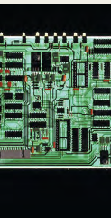
LESSON 8
BOOK CHAPTER 26
CURRENT and RESISTANCE and RC circuits

Slide 2
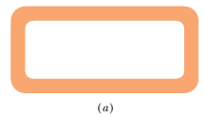
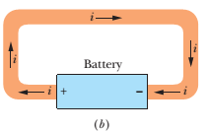
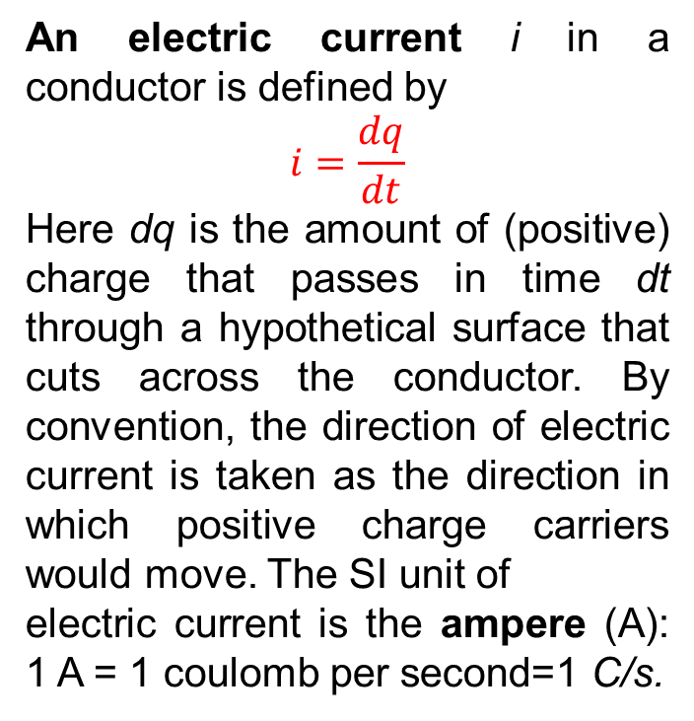
Electric Current:
An electric current i in a conductor is defined by
$$i=\frac{dq}{dt}$$
Here dq is the amount of (positive) charge that passes in time dt through a hypothetical surface that cuts across the conductor. By convention, the direction of electric current is taken as the direction in which positive charge carriers would move. The SI unit of
electric current is the ampere (A): 1 A = 1 coulomb per second=1 C/s.
a) No electric field can exist within it or along its surface. Although conduction electrons are available, no net electric force acts on them and thus there is no current.(b) We insert a battery in the loop, the conducting loop is no longer at a single potential. Electric fields act inside the material making up the loop, exerting forces on the conduction electrons, causing them to move and thus establishing a current.
NOTE: A current arrow is drawn in the direction in which positive charge carriers would move, even if the actual charge carriers are negative and move in the opposite direction.

Slide 3
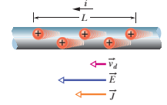

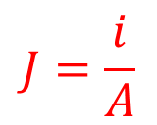
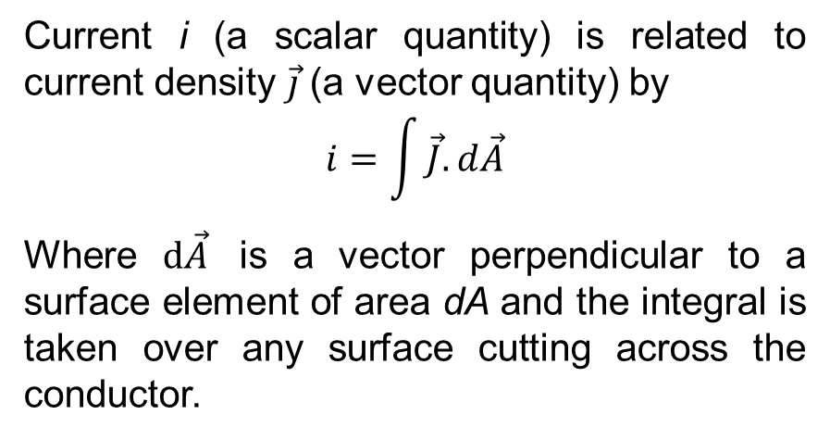
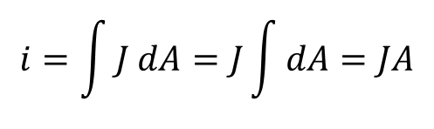
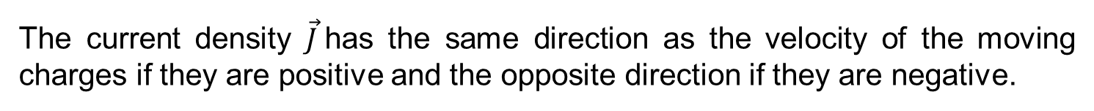
Current Density:
Current i (a scalar quantity) is related to current density $\vec{j}$(a vector quantity) by
$$i=\int{\vec{J}. d\vec{A}}$$
Where $d\vec{A}$ is a vector perpendicular to a surface element of area dA and the integral is taken over any surface cutting across the conductor.
The current density $\vec{J}$has the same direction as the velocity of the moving charges if they are positive and the opposite direction if they are negative.
If the current is uniform across the surface and parallel to $d\vec{A}$ then $\vec{J}$ is also uniform and parallel to $d\vec{A}$ Then the above equation becomes
$$i=\int{J dA=J\int{dA=JA}}$$
$$J=\frac{i}{A}$$
That is, for each element of the cross section, the magnitude J is equal to the current per unit area through that element
Therefore,

Slide 4
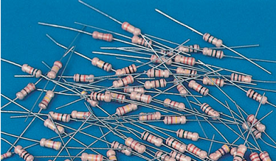
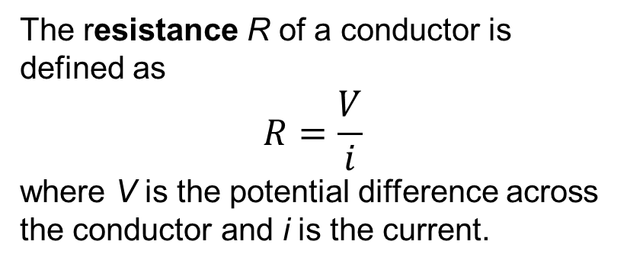

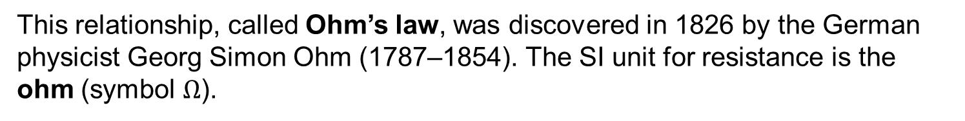
Resistance and Ohm’s Law:
The resistance R of a conductor is defined as
$$R=\frac{V}{i}$$
where V is the potential difference across the conductor and i is the current.
This relationship, called Ohm’s law, was discovered in 1826 by the German physicist Georg Simon Ohm (1787–1854). The SI unit for resistance is the ohm (symbol $Ω$).
$$1Ω=1 volt per ampere=1 V/A$$
A conductor whose function in a circuit is to provide a specified resistance is called a resistor (as shown in the adjacent figure). In a circuit diagram, we represent a resistor and a resistance with the symbol .

Slide 5
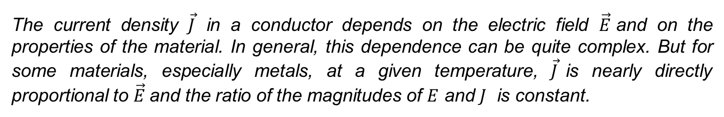
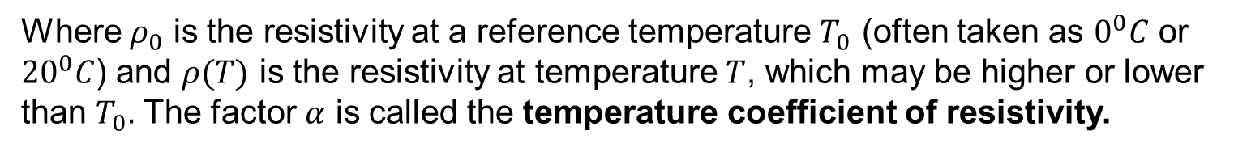

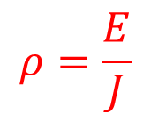
Resistivity:
The current density $\vec{J}$ in a conductor depends on the electric field $\vec{E}$and on the properties of the material. In general, this dependence can be quite complex. But for some materials, especially metals, at a given temperature, $\vec{J}$is nearly directly proportional to $\vec{E}$and the ratio of the magnitudes of $E$ and $J$ is constant.
We define the resistivity $ρ$ of a material as the ratio of the magnitudes of electric field ($E)$ and current density ($J)$:
$$ρ=\frac{E}{J}$$
The greater the resistivity, the greater the field needed to cause a given current density.
Note:
The resistivity of a metallic conductor nearly always increases with increasing temperature as
$$ρ\left(T\right)=ρ_{0}\left[1+α(T−T_{0})\right]$$
Where $ρ_{0}$ is the resistivity at a reference temperature $T_{0}$ (often taken as $0^{0}C$ or ${20}^{0}C$) and $ρ(T)$ is the resistivity at temperature $T$, which may be higher or lower than $T_{0}.$ The factor $α$ is called the temperature coefficient of resistivity.

Slide 6
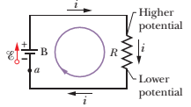
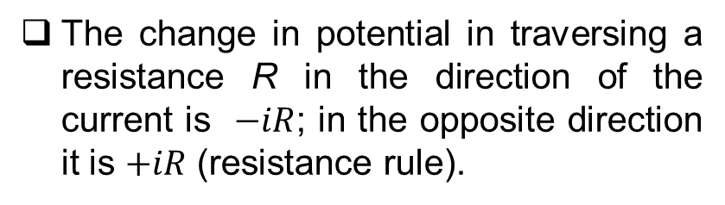

Loop Rule (Kirchhoff’s voltage law): (Book Chapter 27):
The algebraic sum of the changes in potential encountered in a complete traversal of any loop of a circuit must be zero.
This is often referred to as Kirchhoff’s loop rule (or Kirchhoff’s voltage law), after German physicist Gustav Robert Kirchhoff.
That is
$$ε+(−iR)=0$$
Note:
The change in potential in traversing a resistance R in the direction of the current is $−iR$; in the opposite direction it is $+iR$ (resistance rule).
The change in potential in traversing an ideal emf device in the direction of the emf arrow is $+ε$; in the opposite direction it is $−ε$ (emf rule).

Slide 7
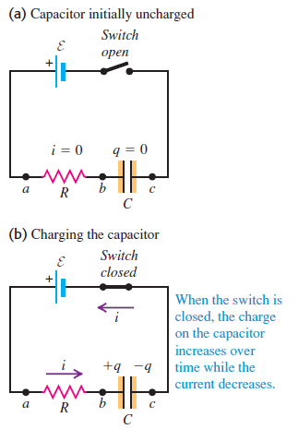








RC circuit
Charging the capacitor
Let q represent the charge on the capacitor and i the current in the circuit at some time t after the switch has been closed.
The instantaneous potential differences V_{ab} and V_{bc} are,
V_{ab} = iR and V_{bc} = q/C
Using these in Kirchhoff’s loop rule, we find
$$ε−iR−\frac{q}{C}=0$$
Or, $i=\frac{ε}{R}−\frac{q}{RC}$
Or, $\frac{dq}{dt}=\frac{ε}{R}−\frac{q}{RC}$
Or, $\frac{dq}{dt}=\frac{ε}{R}−\frac{q}{RC}=−\frac{1}{RC}(q−Cε)$
Or, $\frac{dq}{(q−Cε)}=−\frac{dt}{RC}$
Or, $\int_{0}^{q}{\frac{dq^{/}}{(q^{/}−Cε)}}$ $=−\int_{0}^{t}{\frac{dt^{/}}{RC}}$
Or, $ln\frac{(q−Cε)}{−Cε}=−\frac{t}{RC}$
Or, $\frac{(q−Cε)}{−Cε}=e^{−\frac{t}{RC}}$

Slide 8
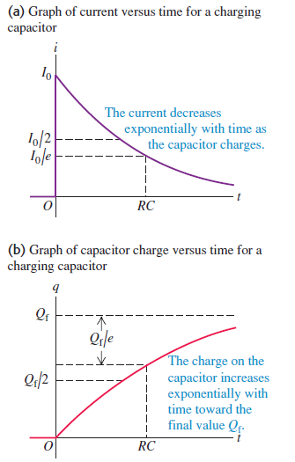
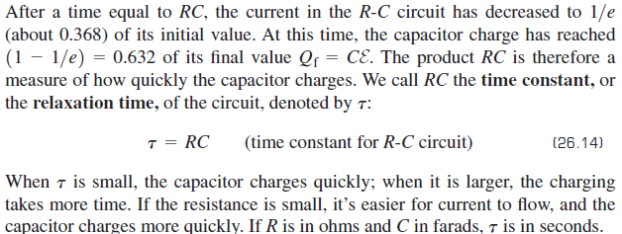
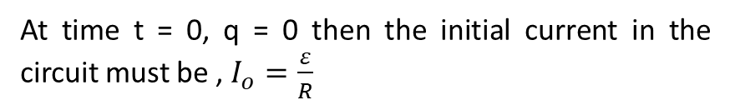
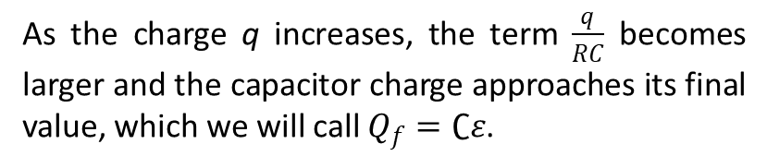

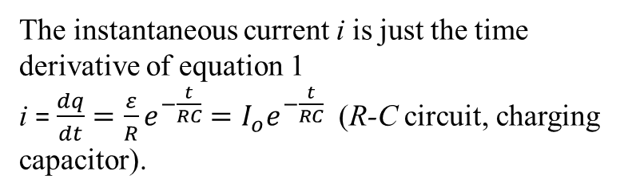
$$or, q=Cε(1−e^{−\frac{t}{RC}})⋯⋯⋯⋯⋯⋯1$$
At time t = 0, q = 0 then the initial current in the circuit must be , $I_{o}=\frac{ε}{R}$
As the charge q increases, the term $\frac{q}{RC}$ becomes larger and the capacitor charge approaches its final value, which we will call $Q_{f}=∁ε$.
The instantaneous current i is just the time derivative of equation 1
i = $\frac{dq}{dt}=\frac{ε}{R}e^{−\frac{t}{RC}}=I_{o}e^{−\frac{t}{RC}}$ (R-C circuit, charging capacitor).
Time Constant

Slide 9
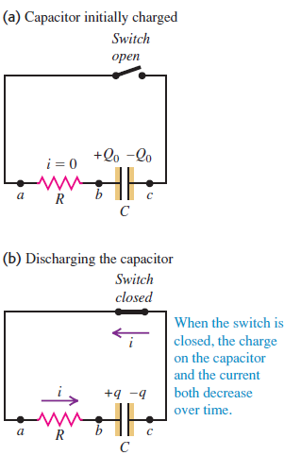
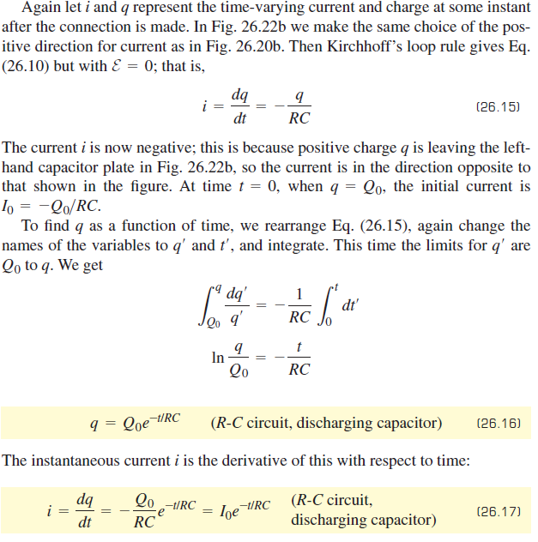
Discharging the capacitor

Slide 10
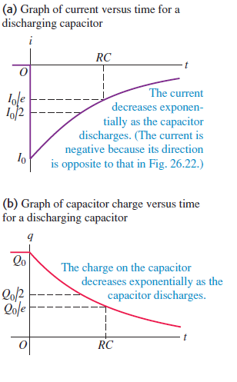
Discharging the capacitor

Slide 11
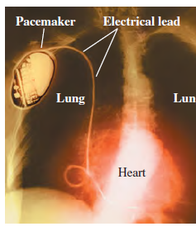
Application: Pacemakers and Capacitors
This x-ray image shows a pacemaker implanted in a patient with a malfunctioning sinoatrial node, the part of the heart that generates the electrical signal to trigger heartbeats.
The pacemaker circuit contains a battery, a capacitor, and a computer-controlled switch. To maintain regular beating, once per second the switch discharges the capacitor and sends an electrical pulse along the lead to the heart. The switch then flips to allow the capacitor to recharge for the next pulse.

Slide 12
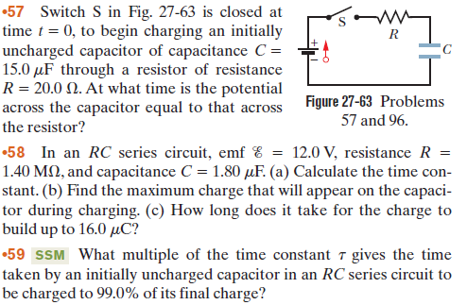
Let’s try !!!

Slide 13

Thank You

